Slide 1
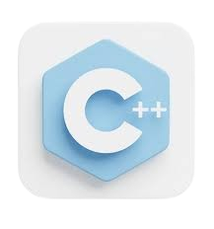

Lecture 3 – Fundamentals - 1
Programming Fundamentals with C++
Dr. Muhammad Sajjad
R.A Asad Ullah

Slide 2

Overview
Variables and Constant
What is a variable?
What is a constant?
Why we use constant
Type Conversion
What is Type Conversion?
Types
Example Code
Arithmetic Operators
What are Arithmetic Operators?
Examples of Each Operator
Notes on Division and Modulus
Arithmetic Expression & Order of Precedence
What is Operator Precedence?
Operator Precedence Table (Basic)
Using Parentheses to Control Order

Slide 3
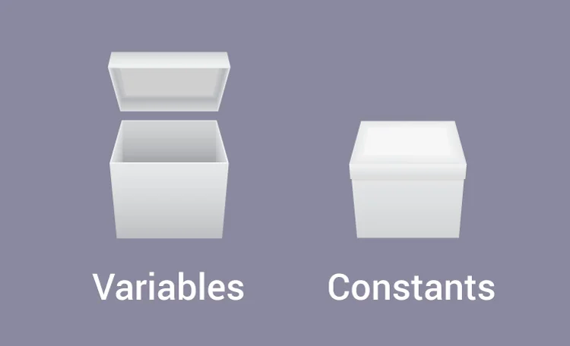
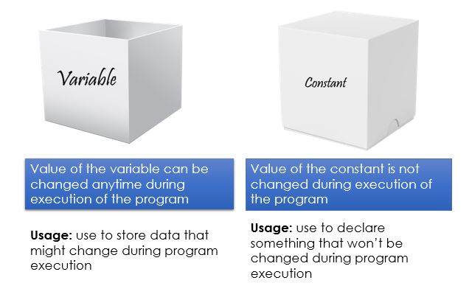
Variables and Constant
Variables
Definition: Variables are like containers in a program that hold data values which can be changed as the program runs.
Syntax: type variable_name = value;
Example: int age = 20; // 'int' is the type, 'age' is the variable name, and 20 is the value stored
Constant
Definition: Constants are like variables, but once assigned a value, they cannot be changed. This is useful for values that should stay the same, such as mathematical constants.
Syntax: const type variable_name = value;
Example: const float PI = 3.14; // PI will remain 3.14 throughout the program
Constants ensure that a value does not accidentally change. For instance, PI is a constant because the value of π doesn’t change.

Slide 4
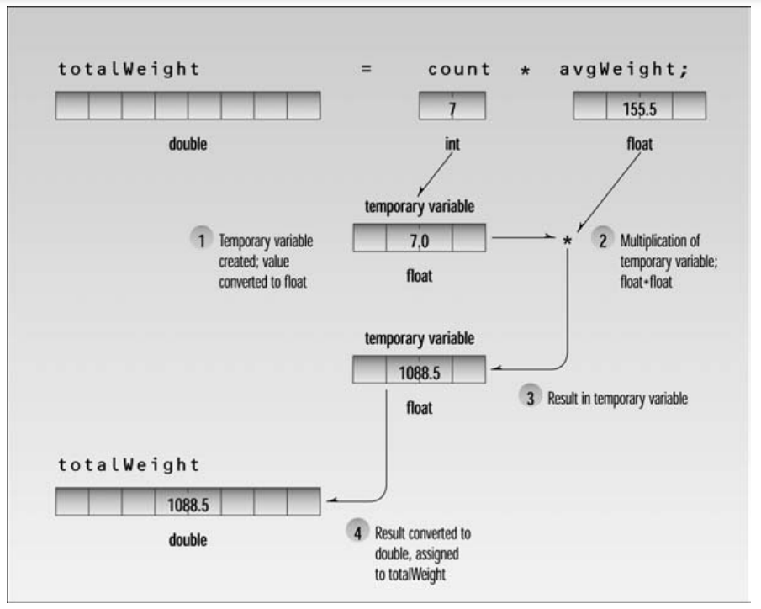
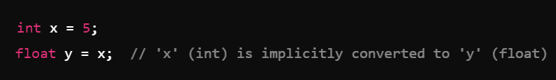
Type Conversion
Definition
Type conversion is the process of converting a variable from one data type to another. This can be implicit (automatic) or explicit (manual or forced by the programmer).
Types of Type Conversion
Type conversion is the process of converting a variable from one data type to another. This can be implicit (automatic) or explicit (manual or forced by the programmer).
Implicit Conversion:
C++ will automatically convert data types when it makes sense, such as converting a smaller type to a larger one (e.g., int to float).
This is often safe but can sometimes lead to precision loss (e.g., from float to int).

Slide 5
Type Conversion
Implicit Conversion:
Examples

Slide 6
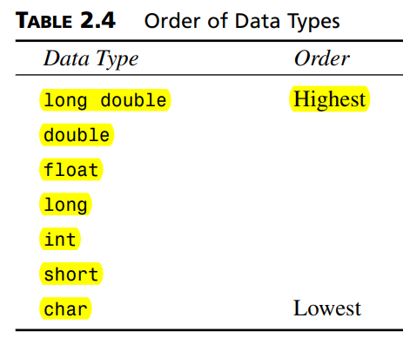
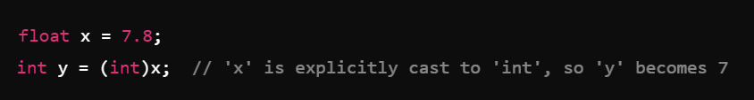
Type Conversion
Explicit Conversion (Casting):
The programmer specifically tells C++ to convert a type using casting.
Syntax: (new_type) variable
Why Use Type Conversion?
Type conversion allows mixing different types, like combining integers and decimals.
Example scenario: Calculating an average where dividing integers might require a float for a precise result.

Slide 7
Type Conversion
Explicit Conversion (Casting):
Examples

Slide 8
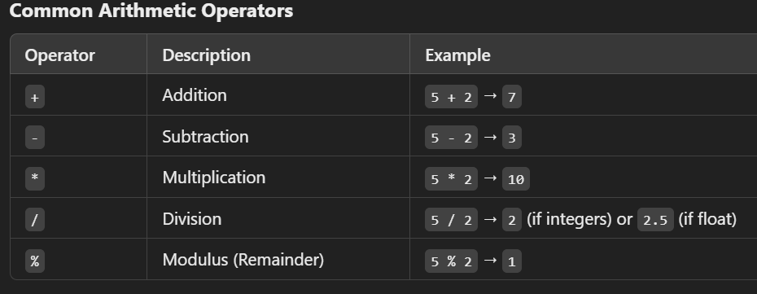
Arithmetic Operators
What are Arithmetic Operators?
Arithmetic operators perform basic mathematical operations on variables and values.
Notes on Division and Modulus?
Division of two integers results in an integer, removing the decimal part. Use float if you need a decimal result.
Modulus is used only with integers to get the remainder.

Slide 9
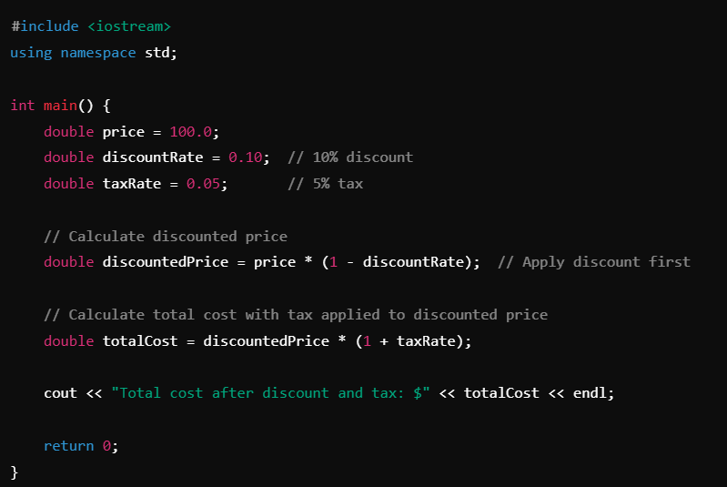
Arithmetic Expression & Order of Precedence
What are Arithmetic Expressions?
Arithmetic expressions in C++ involve using operators to perform mathematical calculations on variables and constants. These operations follow standard mathematical rules.
Order of Precedence
When combining multiple operators in a single expression, C++ follows a specific order to decide which operations to perform first. This is called operator precedence.

Slide 10

Arithmetic Expression & Order of Precedence
Precedence Rules
Parentheses (): Operations inside parentheses are performed first.
Multiplication *, Division /, and Modulus %: These have higher precedence than addition and subtraction.
Addition + and Subtraction - : These are evaluated last among the basic arithmetic operators.
Associativity
Operators with the same precedence level are evaluated based on associativity:
Left-to-Right Associativity: Operators having same precedence like (+, -), ( *, /, and %) are evaluated from left to right.
To override precedence, use parentheses:

Slide 11
Thank You

